Slide 1
E-FIR/Electronic First Information Report

Slide 2
ABSRACT OF THE PROJECT
The E- First Information Report System (E- FIR) represents a paradigm shift in law enforcement, harnessing advanced technologies to optimize crime prevention and investigation. Integrating Web development with the FIR System empowers law enforcement agencies to predict and respond to criminal activities efficiently. Key components include Filing a FIR and then looking into the status and reports of that FIR and many other features. As agencies globally embrace digital transformation, the E- FIR emerges as a pivotal tool, promising to revolutionize traditional policing and foster safer communities.

Slide 3
INTRODUCTION
E-FIR (Electronic First Information Report) is a digital version of the FIR (First Information Report) that can be filed online through the official website of the police department. It allows individuals to report a crime without having to physically visit the police station, making it a convenient and efficient and also we can check the status and reports of the given complaint which gives the citizens the transparency of the case.
we are taking a significant step toward a more accountable and responsive justice system.

Slide 4
OBJECTIVES
Online Reporting:
E-FIR systems allow individuals to file a report online, eliminating the need to visit a police station in person.
Digital Submission:
The complainant can submit all necessary details and documents in a digital format, making the process more efficient and reducing paperwork.

Slide 5
User Authentication:
E-FIR platforms usually include a system for authenticating the identity of the complainant to ensure the legality of the report.
Status Tracking:
Complainants can track the status and progress of their E-FIR online, providing transparency in the investigation process.
Transparency:
As every report can be seen by the police and the person who has lodged the complaint we can say that there will be more transparency of the investigation to the citizen.

Slide 6
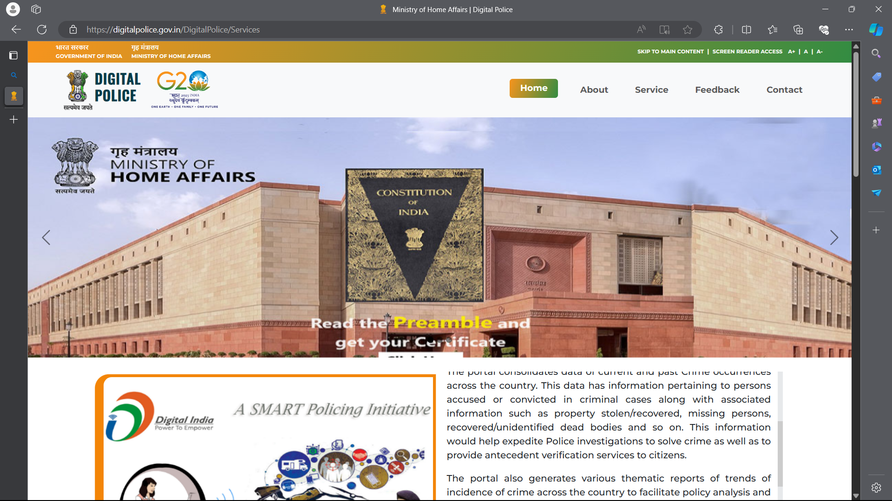
EXISTING SYSTEM
Existing system is known as DIGITAL POLICE by the government of India . It consists of giving many types of complaints online. It consists of many features such as service , contact detaila and service about that feedback and etc., It is mainly used to only give complaints through online without going to the police station they may be recorded as 0-FIR or normal FIR

Slide 7
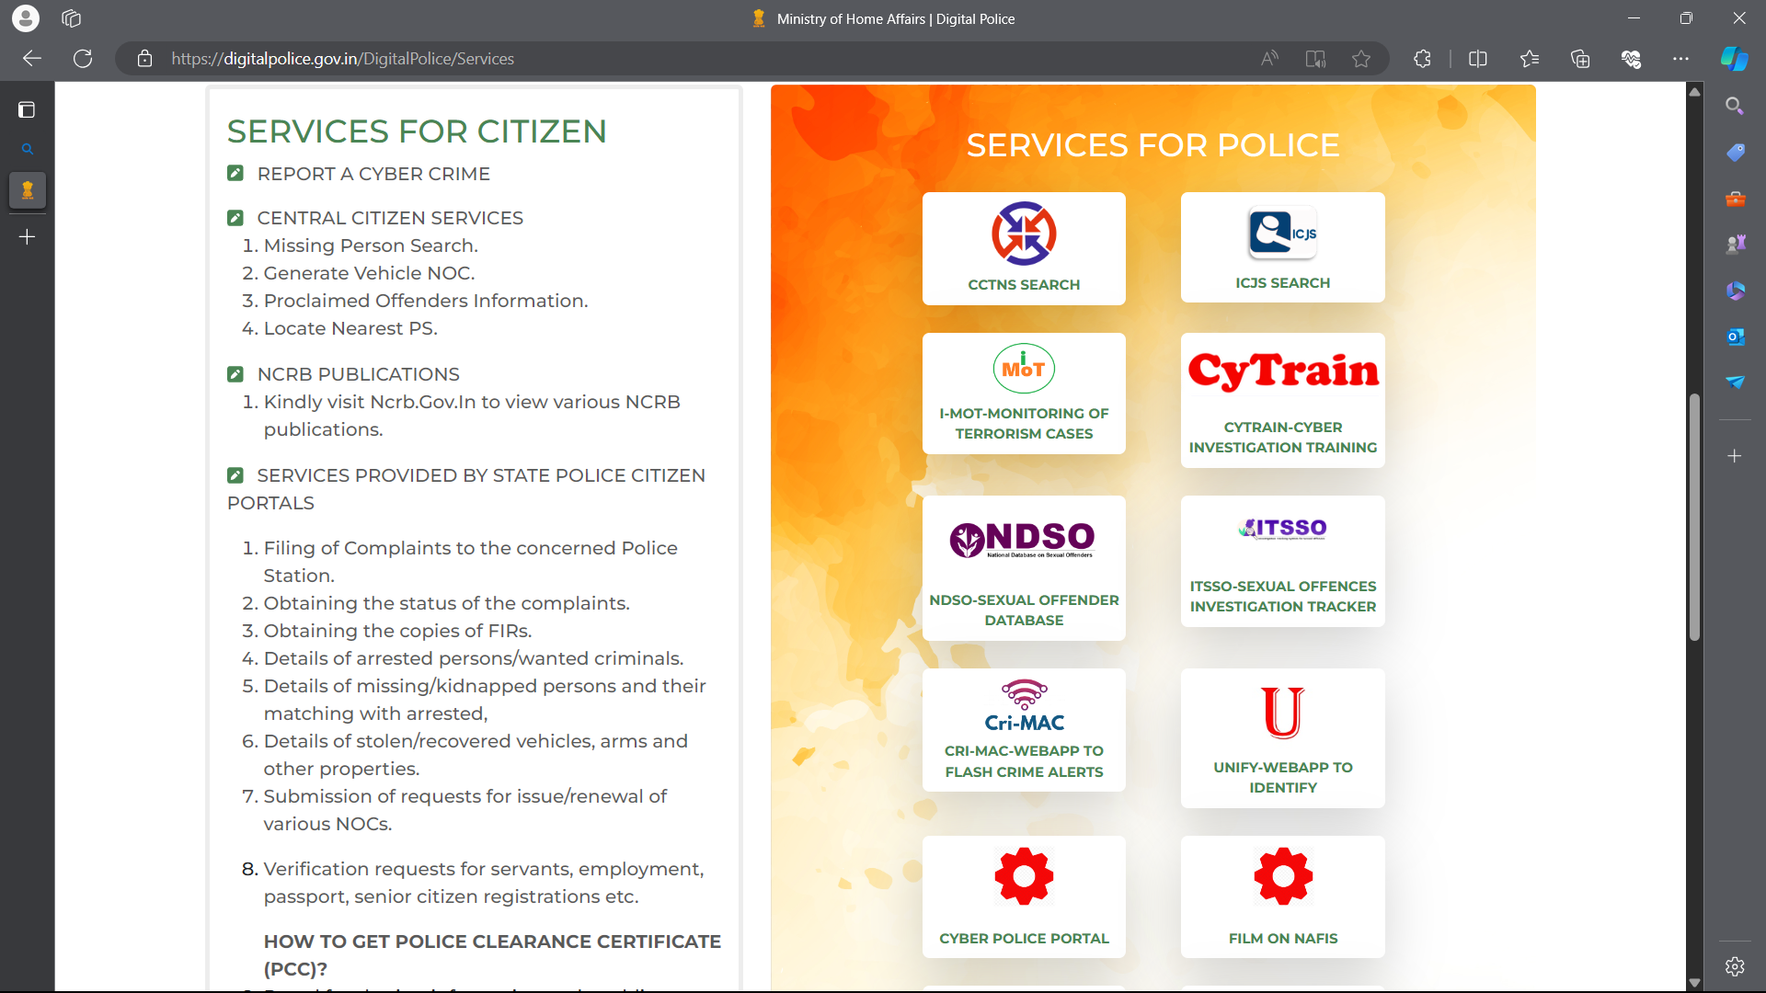
DISADVANTAGES OF EXISTING SYSTEM
It does not show the status either it is closed or open
Getting a copy of FIR contains of a lot of process
The police cannot store or upload the files related to the case
Less transparency to the people
Less secure due to lack of registration facility to the complainer.
No better keep track of evidence
Partially manual which is time consuming

Slide 8
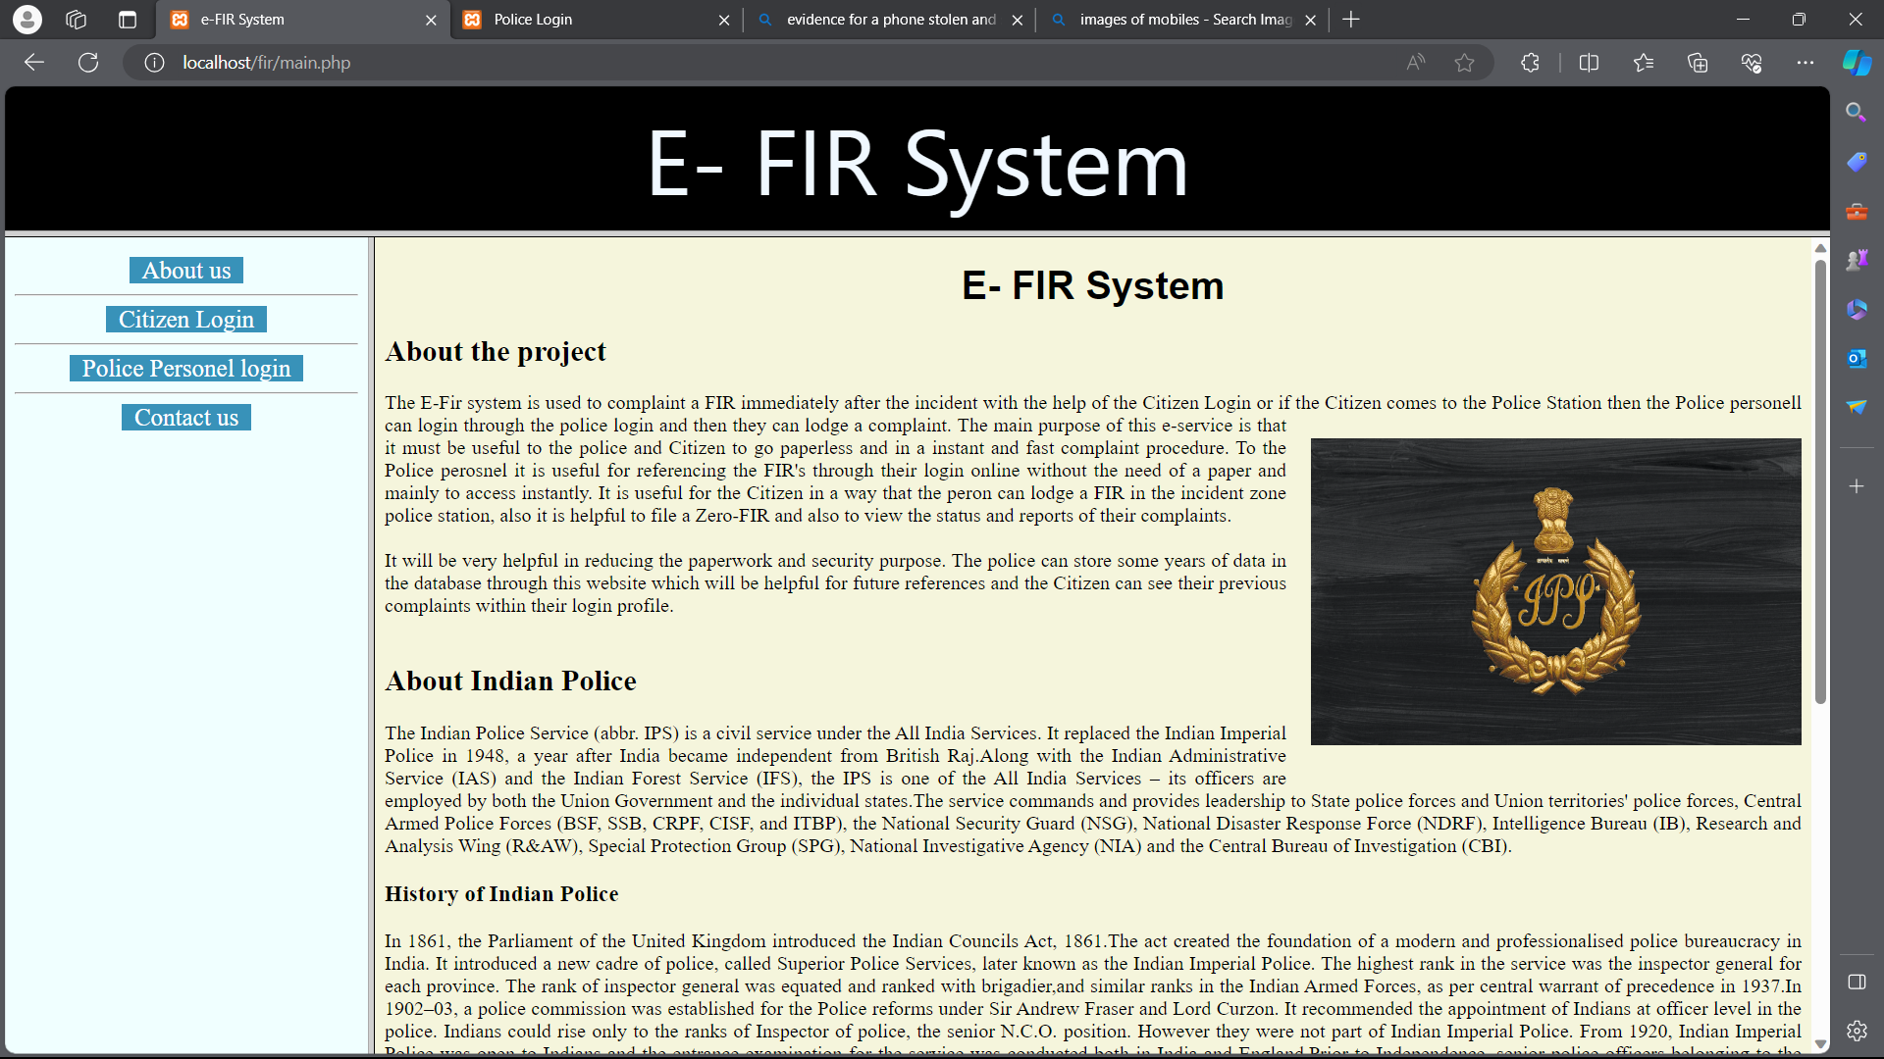
Proposed system
The E-FIR System is a online digital policing system which consists all the features of the DIGITAL POLICE (Existing Features) and it also consists of many other features which overcomes the disadvantages of the existing system. It consists of both the police and citizen login.

Slide 9
ADVANTAGES
The advantage of E-FIR is that it saves time and resources, as it eliminates the need for physical visits to the police station. It also provides a quick and efficient way to report incidents, making it easier for law enforcement to take action.
More transparency of the case to the citizens which increases the trust on police.
Development of police to citizen relationship
The citizens can be able to view the status or reports of the case without going to the police station which decreases the physical visits to the police station
The police can store the FIR’s and reports in virtual form which makes it very easy for retrieval and for future requirements.

Slide 10
TECHNOLOGY USED
FRONT-END-HTML,CSS,JAVA SCRIPT,JSON
BACK-END-PHP

Slide 11
MODULES
USER
POLICE

Slide 12
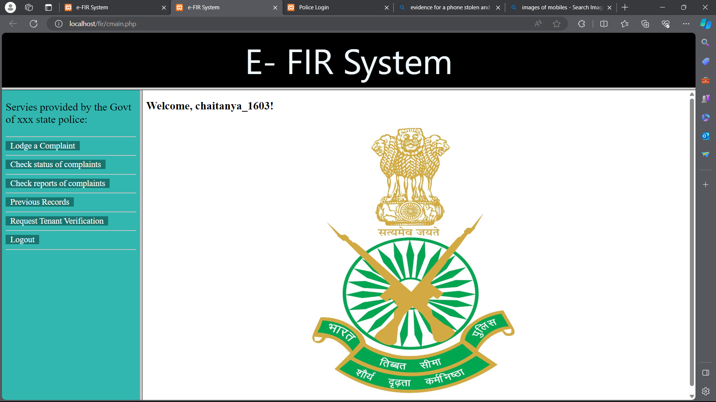
PROPOSED SYSTEM(CITIZEN LOGIN)
The CITIZEN LOGIN consists of many services such as lodging a complaint, check the status of the complaint, check the reports or files related to that complaints, previous records or FIR’s and finally verification.
This login can be further developed into lodging different types of complaints in different forms which makes it user friendly.

Slide 13
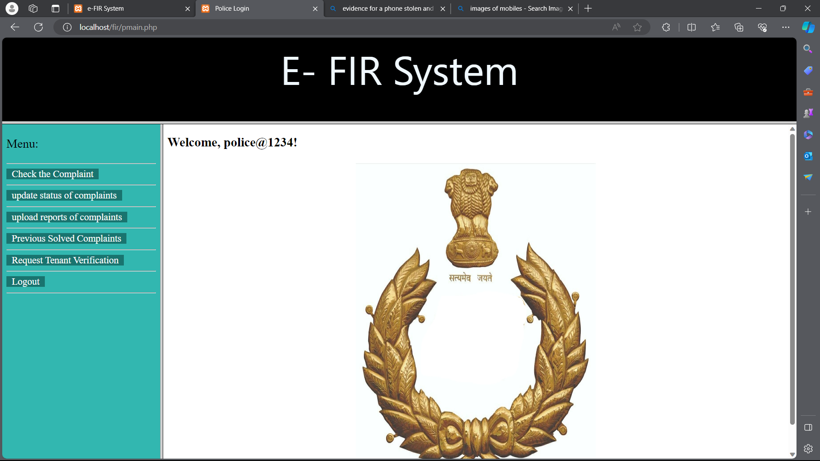
PROPOSED SYSTEM(POLICE LOGIN)
The POLICE LOGIN consists of many features such as to check the new arrival of the complaints in that particular police station, to upload the files/ reports related to the case they are working on, to update the status of the cases present in that police station, to see the records of the previously solved complaints and also to check the requests of the user verification which enables high security to the house owners.

Slide 14
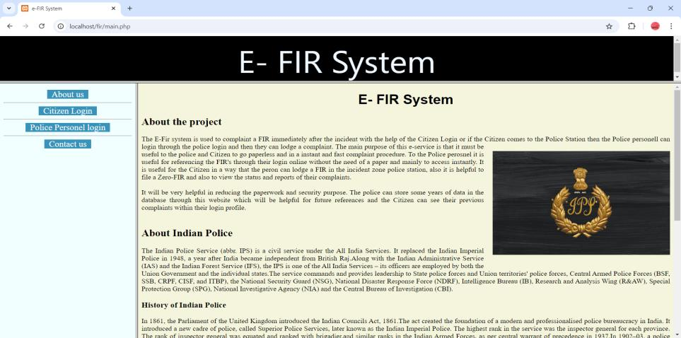
Output screens

Slide 15
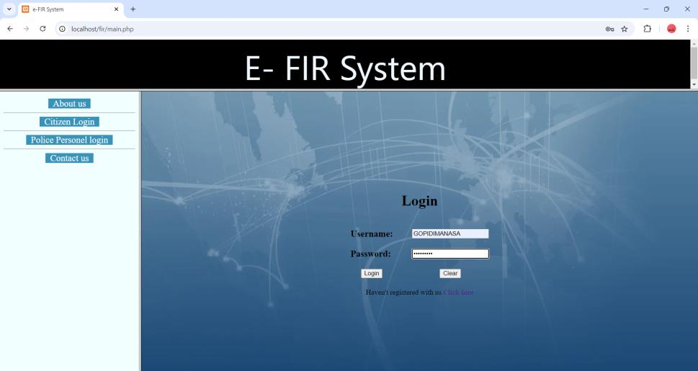
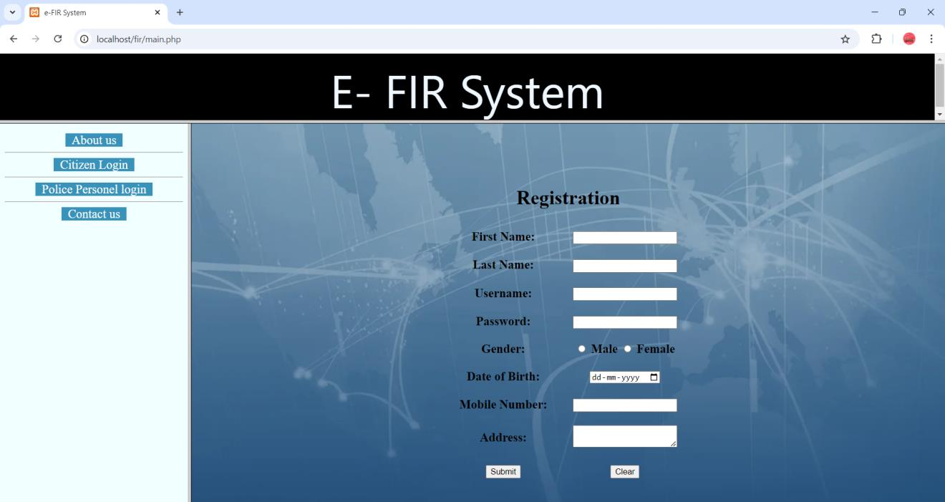

Slide 16
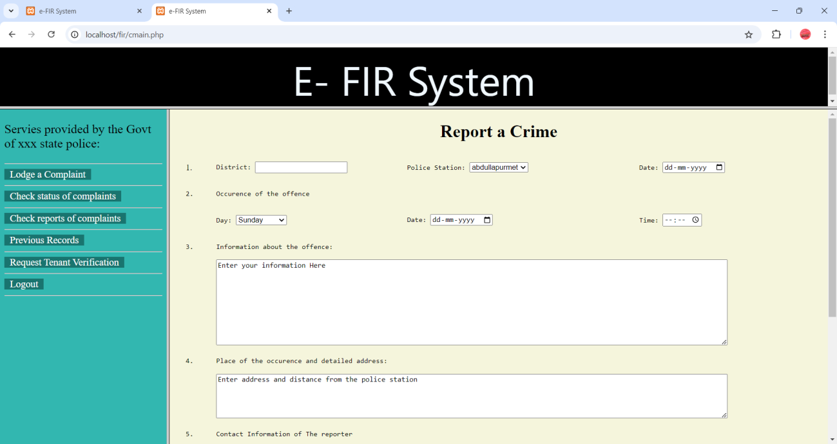

Slide 17
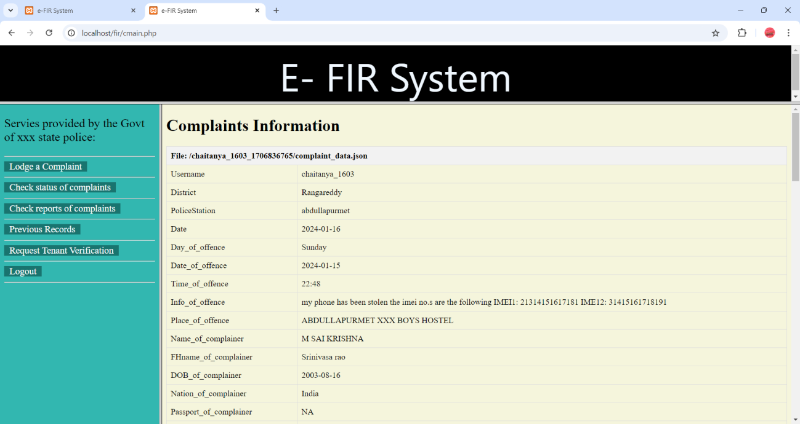

Slide 18
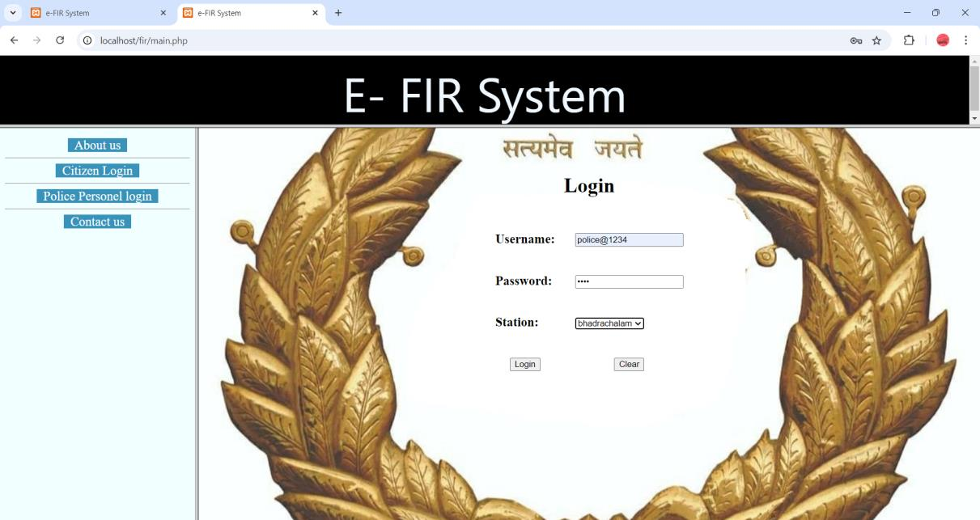

Slide 19
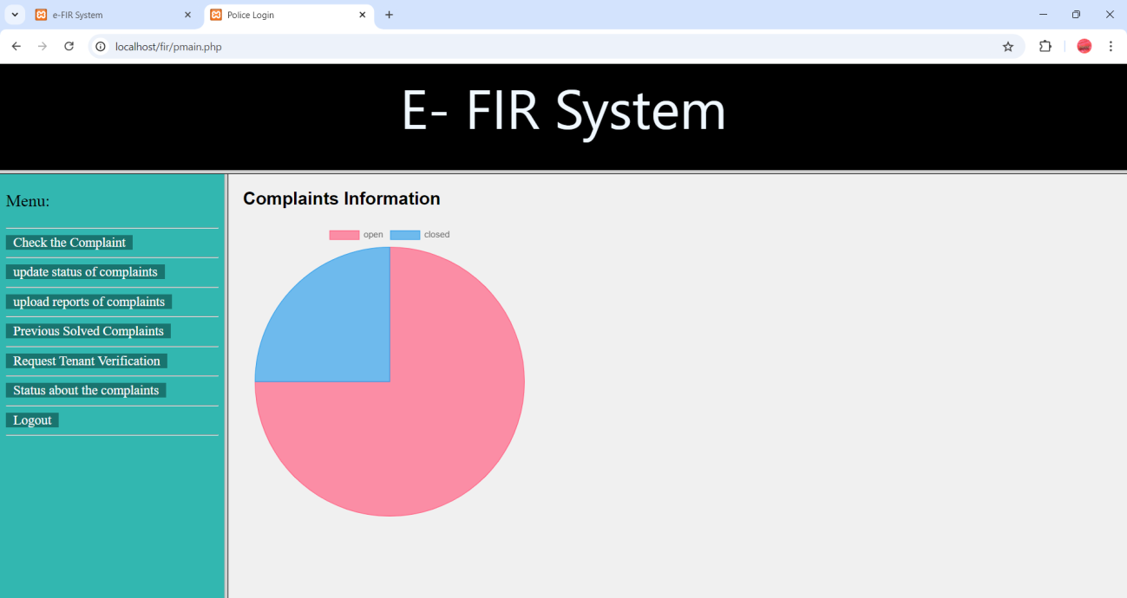

Slide 20
conclusion
In conclusion, the E-FIR system is not just a technological innovation; it is a step towards a more accessible, transparent, and efficient justice system. By bridging the gap between the
public and law enforcement, the system contributes to the creation of safer communities and a more accountable policing framework.

Slide 21

Any queries ?

Slide 22
Thank YOU!

